Slide 1
The Restoration and Enlightenment
1660 - 1798

Slide 2
Kings and queens
(1660-1789)
Charles II
James II
William III and Mary II
Anne
George I
George II
George III

Slide 4
Elements of belief during the Enlightenment (Age of Reason
Confidence in human spirit
Everything in nature has a design and purpose
Disharmony is an illusion
Emphasis on order, harmony, and stability
Believed in progress

Slide 5
Changes in Religion
The new science influenced religion: A movement called Deism viewed the universe as a perfect mechanism, which God had build and left to run on its own.
“The Great Watchmaker”
Christianity still rules lives, but people began asking more and more scientific questions
Notables of the Time: Alexander Pope, Sir Isaac Newton
Renewed interest in the classical writers, such as Aristotle, remind English thinkers of the power of the scientific method.

Slide 6
Writers drew on “New Classical” style of Roman, Greek, and Latin models
Thinkers of this Age of Reason emphasized logic, scientific observation, factual explanation. These rational explanations affected some people’s religious views.
Literary tastes turned to wit and satire to expose excesses and moral corruption.

Slide 7
After James I, his weak son Charles I came to throne, but the Puritans and their parliamentary party had gained power.
By 1642 England was embroiled in civil war between the parliamentary party and the Royalists. HH - The English Civil War
Charles I was Beheaded by Parliament as they took over England under the rule of Oliver Cromwell—not royalty but a military and political strategist who eventually tore up the constitution and became a dictator.

Slide 8
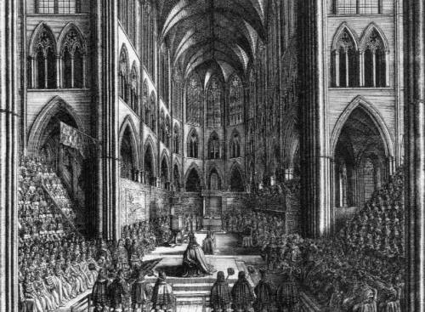
In 1660 the Anglican Church was restored as the official Church of England and King Charles II was restored to power (after having been exiled to France, restoring the monarchy.)
They dug up Cromwell, beheaded him, then reburied him.
The monarchy was restored without shedding a drop of blood.
Westminster Abbey
April 23, 1660

Slide 9
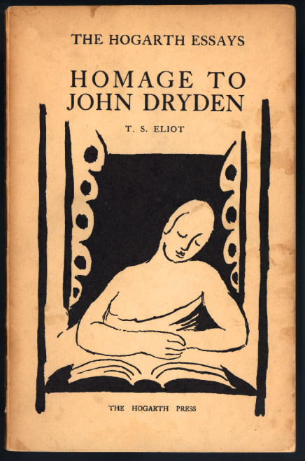
Rebirth of Theatre
Puritan disapproval of the theatre diminishes in this century and theatre becomes another outlet for social satire. Restoration comedies addressed social issues like manners. The works were sophisticated in style and mature in content.
John Dryden’s “Essay of Dramatic Poesy” brings Shakespeare back into the limelight.

Slide 10
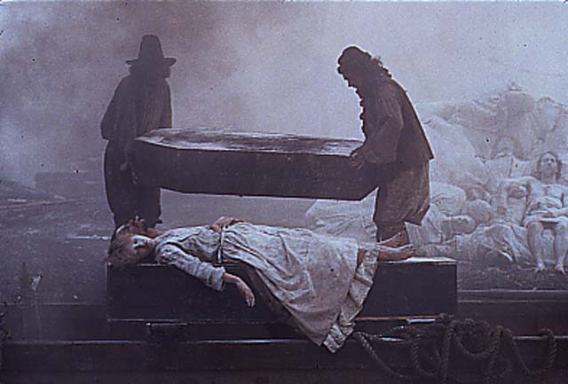
Restoration Society
There’s a huge gap between the wealthy and the poor.
The wealthy waste money while London children and the impoverished die of poor nutrition and health.
Samuel Pepys’ secret diary allows historians a means to experience the inequities and peculiarities of Restoration England. Daniel DeFoe’s Journal of a Plague Year documents the year 1665, which brought mass destruction to England.

Slide 11
Disasters after the Restoration
Plague (killed 70,000 people)
Great Fire (half of all homes in London were destroyed)
HH - The Plague and the Great Fire of London
The Great Fire of London - animated with Legos

Slide 12
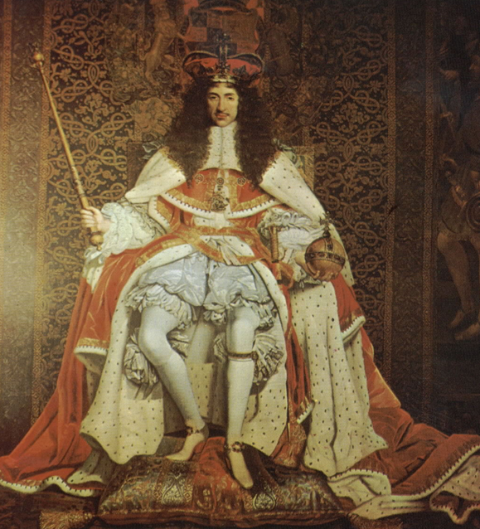
Charles II (1660-1685)
Theatre patents
Court circle
No heirs
Numerous mistresses
Succession crisis
Founder of the Royal Society
Patron of the arts
HH - Charles II: King of Bling

Slide 13
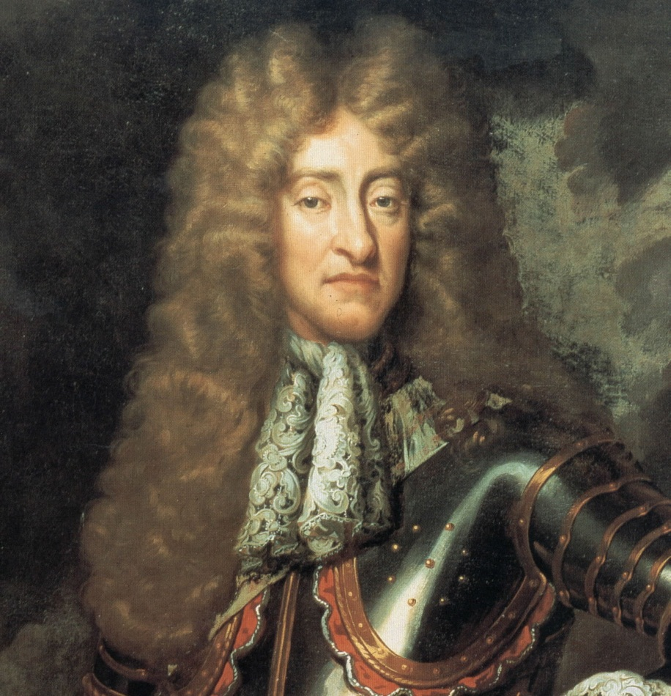
James II (1685-1688)
Zealous Catholic
Forced to flee
Jacobite descendants: the Pretender, the Young Pretender (“Bonnie Prince Charlie”—1745)
James II

Slide 14
The Glorious Revolution
Parliament asked Mary (Protestant Daughter of James II from his first marriage) to rule jointly with her husband William of Orange. They arrived in England prepared to fight for the throne, but James II stepped down and fled. No blood was shed during this revolution

Slide 15
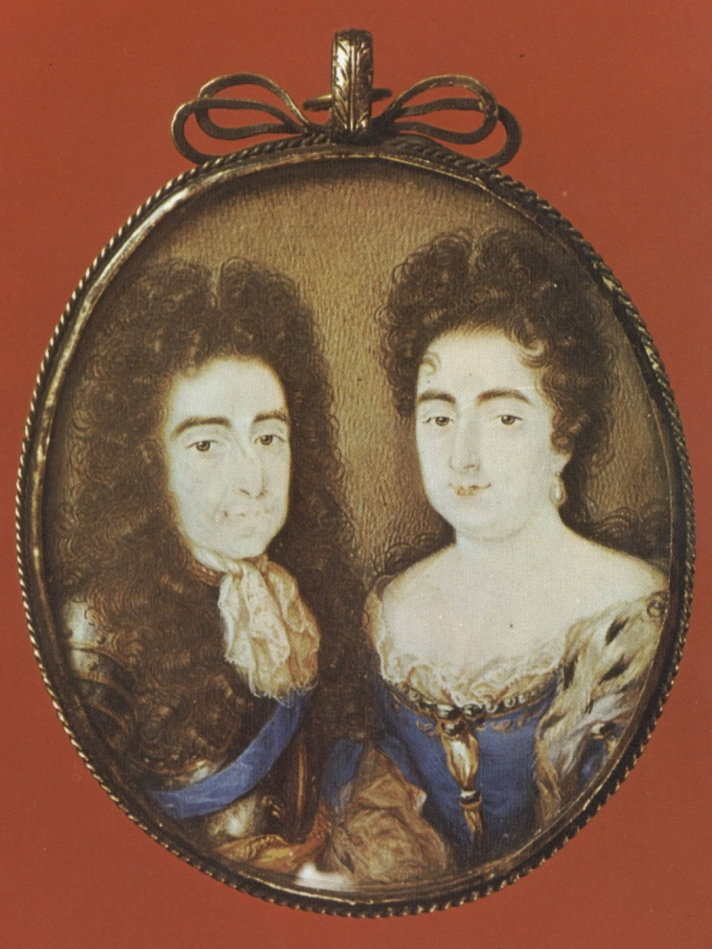
William III & Mary II (1689-1702)
First and only joint monarchs
Mary: daughter of James II; died in 1694
William: Dutch descendant of Charles I through daughter, Louisa (Charles and James’s sister)
William reigns alone until 1702
Wars with the French

Slide 16
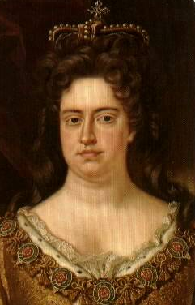
Queen Anne (1702-1714)
Little interest in the theatre or poetry
A builder of churches
17 pregnancies, 5 children, but none lived to adulthood

Slide 17
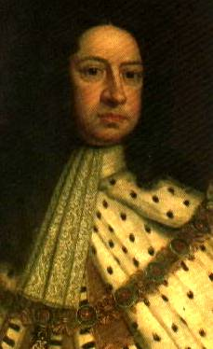
George I (1714-1727)
Non-English speaking
No interest in English culture
Rarely even resided in England
Absence created a “power vacuum”
HH - George I
George I/II

Slide 18
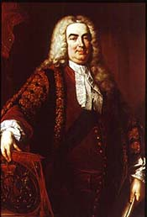
Sir Robert Walpole
1st Lord of the Treasury (Prime Minister)
1718-1742
Strong leader
Patronage network
Target of satire

Slide 19
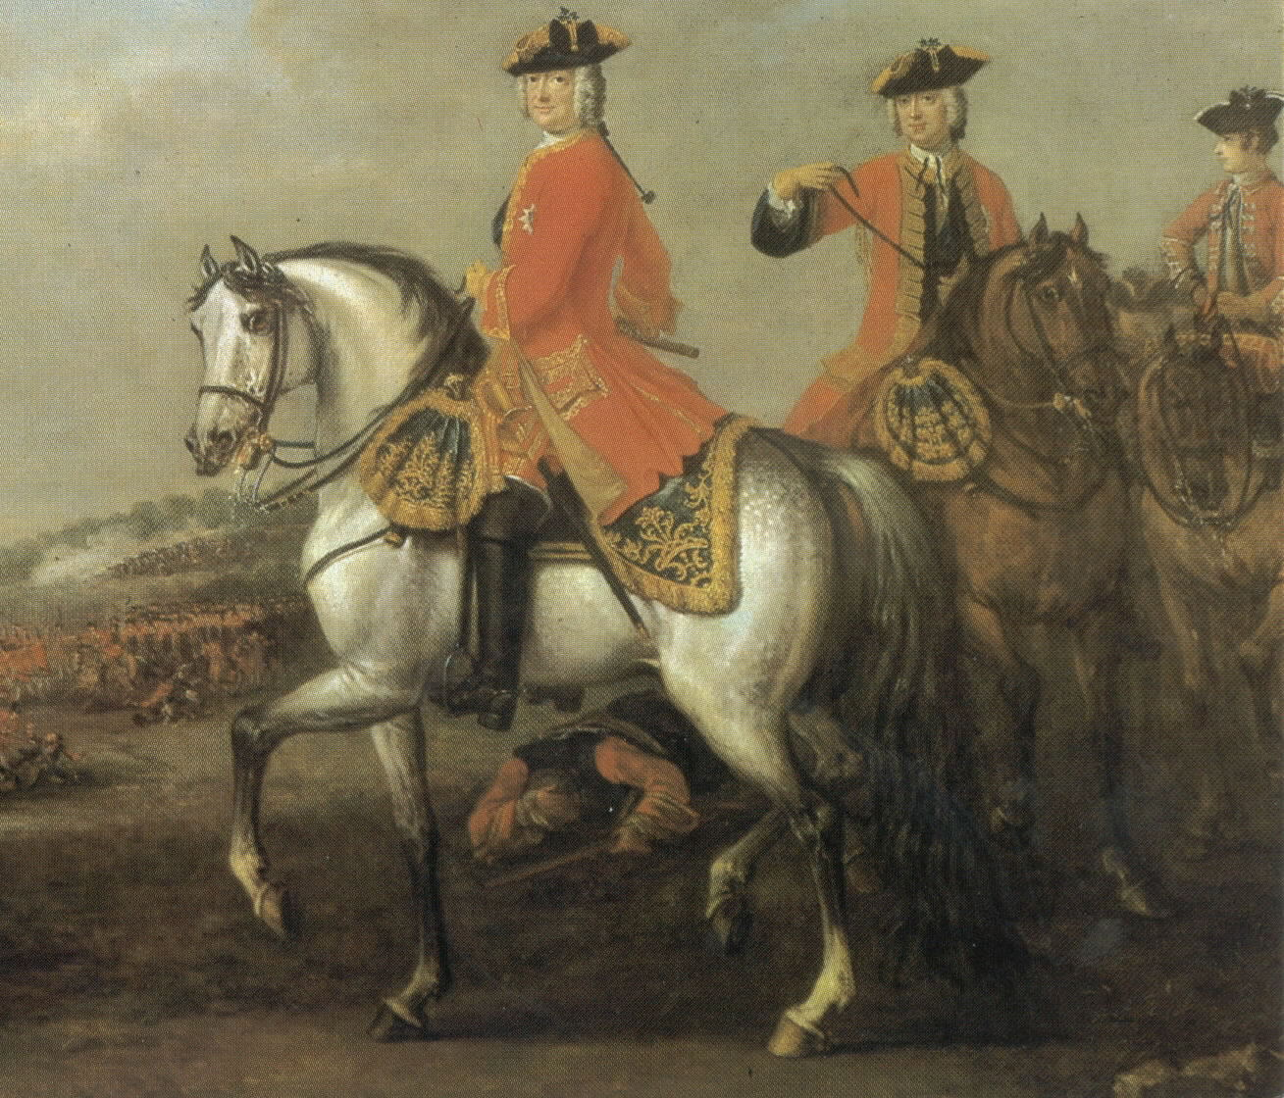
George II (1727-1760)

Slide 20
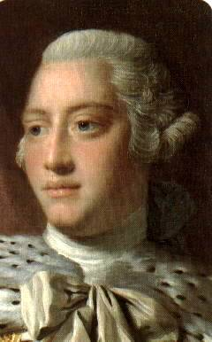
George III (1760-1820)
First “English” king of Hanover
Patron of the arts
Personal library became the core of the British Library

Slide 21
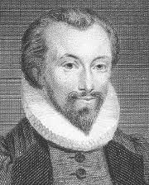
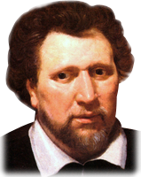
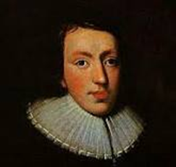
Birth of Modern Prose
English prose became more precise, exact and plain.
Fewer metaphors, flowery language, etc.
Ben Johnson
John Donne
John Milton

Slide 22
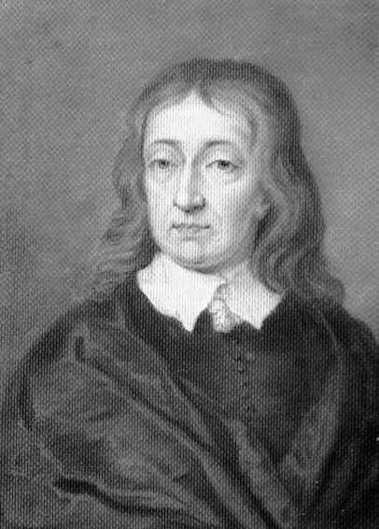
John Milton (1608-1674)
Among the three most important poets of the English literary tradition
Followed the Virgilian model
“L’Allegro” and “Il Penseroso”
Paradise Lost (1667)
Paradise Regained (1672)

Slide 23
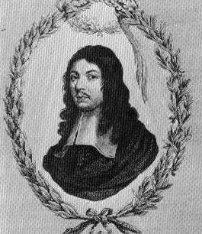
Andrew Marvell (1621-1678)
Secretary to Milton during the Cromwellian era
Published few poems during his life
Miscellaneous Poems (1681)
Important philosophical poet

Slide 24
Authors of the Georgian Period

Slide 25
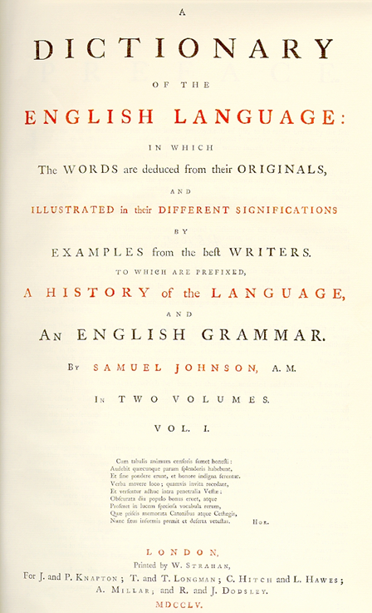
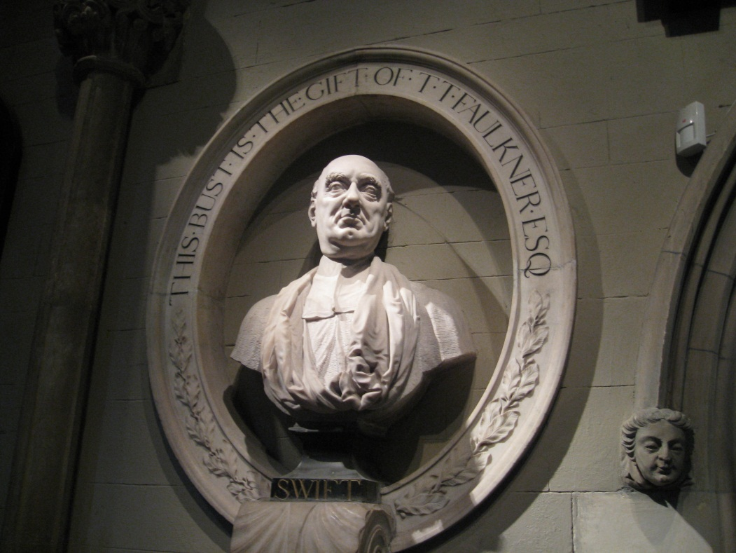
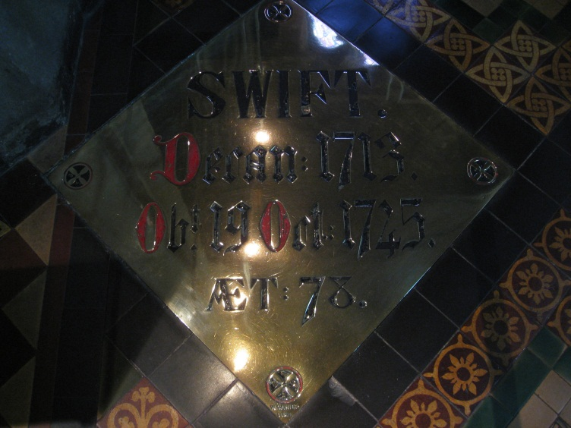
The Restoration was a time to attempt order from chaos.
Samuel Johnson accepted the challenge to construct an English dictionary.
Writers like Alexander Pope and Jonathan Swift revealed social inequities and individual peculiarities with a new, witty satire.

Slide 26
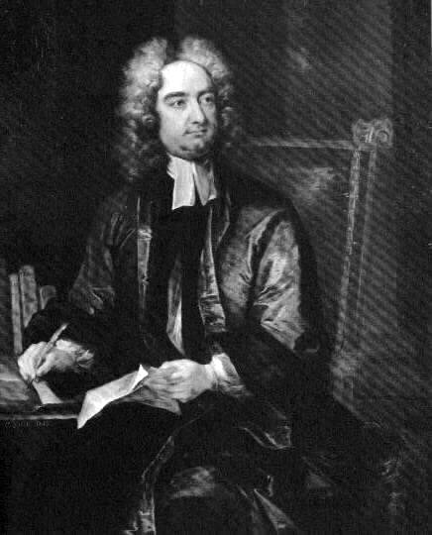
Jonathan Swift (1667-1745)
Greatest satirist of the 18th century
Tale of a Tub (1704) annoyed Queen Anne; sent to Dublin in 1714 when Tories lost power
Gulliver’s Travels (1726)
Modest Proposal (1729)
Biography of Swift

Slide 27
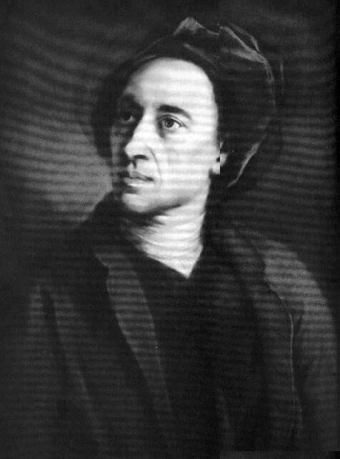
Alexander Pope (1688-1744)
Greatest poet of the early 18th century
Child prodigy
Complex career

Slide 28
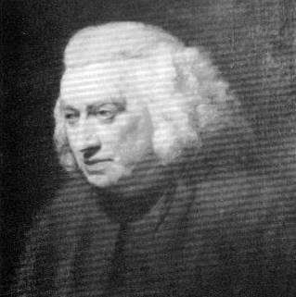
Samuel Johnson (1709-1784)
Poet: “Vanity of Human Wishes” (1749)
Essayist: Rambler, Idler
Playwright: Irene
Editor: Dictionary, Works of Shakespeare
Biographer: Lives of the Poets

Slide 29
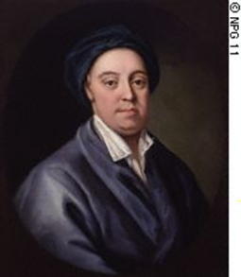
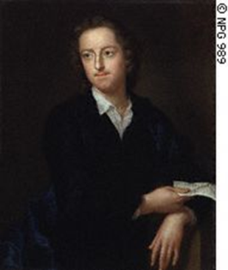
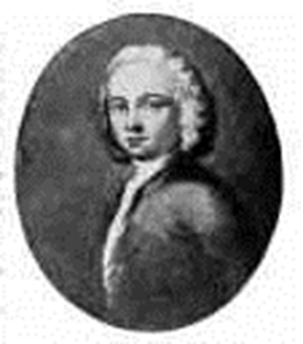
The “New Poetry”
Emphasis on private experience, emotions, moods, reveries
Importance of nature
Interest in lower social classes, general benevolent view of humanity
James Thomson: The Seasons
Thomas Gray: “Elegy Written in a Country Churchyard”
William Collins: Odes

Slide 30
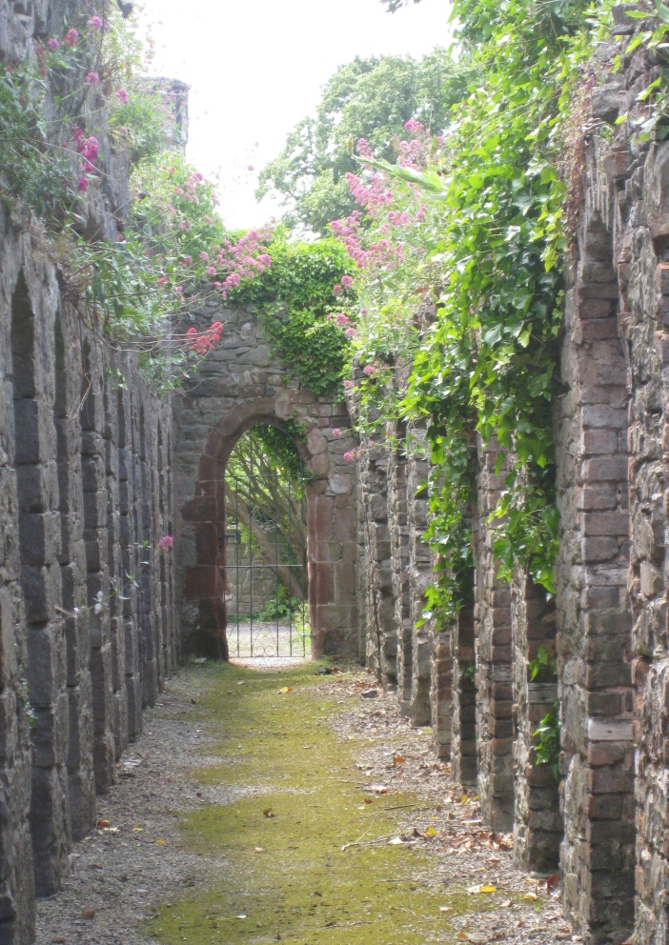
Odes and Elegies
In poetry, the ode and the elegy increase in popularity.
Odes are formal tributes to an honoured, absent subject.
Elegies are similar, yet feature a tone of mourning as they pay tribute someone who has passed on. Thomas Gray’s “Elegy Written in a Country Churchyard” is a famous example from this period.

