Slide 1
12th Grade Research Paper

Slide 2
Quick Overview
We will all read Mary Shelley’s Frankenstein
We will choose whether we want to research a human hero OR a human monster
We will decide and then prove whether this hero or monster was created from nature, nurture, or a combination of both
Let’s watch a video that provides a quick overview on the Nature v Nurture Debate: 60 Minutes Born Good (p. 5 in Hero Packet)
We will compare our human hero or human monster to the fictional hero or monster in Shelley’s Frankenstein

Slide 3
Let’s consider what we covered first semester…
Anglo-Saxons, Middle Ages, and Renaissance
While exploring these literary time periods, we discussed the heroic cycle as well as the monsters a hero must face
Anglo-Saxons: Beowulf faces Grendel, Grendel’s mother, and the dragon
Why did Beowulf want to defeat these creatures?
Remember the importance of one’s name living on forever?
Why did the monsters act the way they did?
Grendel isn’t a part of the community. The dragon is the epitome of greed.
THINK ABOUT: Joseph Campbell’s explanation of the heroic cycle. You will most likely apply this to your brainstorming process.

Slide 4
First, let’s consider what we covered first semester…
During the Middle Ages, we met King Arthur, Sir Gawain, and the various pilgrims in The Canterbury Tales
King Arthur is a hero that creates a democratic environment and loves his country
Sir Gawain follows the rules of chivalry and the importance of keeping one’s word
Many of the pilgrims display characteristics that could be considered “monstrous”
Appearance vs. Reality (Pardoner and his lust for money; The Aristocracy of the Church)

Slide 5
First, let’s consider what we covered first semester…
During the Renaissance, we met Macbeth and Lady Macbeth
Why do these two characters become monsters?
Are they already monsters before the action ensues? Perhaps one is naturally a monster and the other becomes a monster due to his surroundings.
How does Shakespeare explore the nature of evil?
How does Shakespeare explore the environment that creates monsters?

Slide 6
Now, let’s take these ideas from first semester and apply them to the real world.
Joseph Campbell believes that all humans will endure their own heroic cycle:
Start thinking about how the fictional heroes we read about have characteristics that apply to real heroes
Bravery, Courage, Selflessness, Impact on the Community
Now, consider how the hero has evolved or changed throughout time
Remember, Beowulf cares about attaining immortality through his name living on forever. Why do our heroes do the acts that they do? What has changed from the times of the Anglo-Saxons to the 21st century?

Slide 7
Now, let’s take these ideas from first semester and apply them to the real world.
While Campbell believes we will all endure our own heroic cycle, others will perform acts of evil within their community
Start thinking about how the fictional monsters we read about have characteristics that apply to real “monsters”
Greed, Lust for Money, Mental Conditions, Pressure from Society, Hiding One’s True Nature
Remember that Lady Macbeth says how Macbeth’s nature is too kind, which could be why she pressures him to become the monster that he does.
Remember that the dragon symbolizes what can happen to someone who becomes too greedy.
TED RADIO HOUR: The Hero’s Journey

Slide 8
The Lucifer Effect
The Lucifer Effect (23 min – skip 5:15-6:30)
Complete p. 5 in Monsters Packet in packet
Think about HOW this relates to Nature and Nurture
Zimbardo’s Website
The Stanford Prison Experiment Movie (came out in July)

Slide 9
Step One: Research
AT LEAST 5 sources (outside of Frankenstein) are required (4 of which should be articles from the databases or a published nonfiction book)
You will have a total of 6 sources!
If you choose a source from a website that has more of a “pop culture feel,” then you should pair this source with one that is more academic
Please be sure to use videos that are from non-biased sources
If you decide to use more than one video, then this should be your sixth source
* Wikipedia is not a valid source for this paper. You should avoid most websites that you find from Google, Yahoo etc…*

Slide 10
Let’s Pause and Look at the Rubric!
Hero – pp. 20-21
Monster – pp. 23-24
The Rubric will be collected the day you turn-in your research paper

Slide 11
Step Two: Is the Research Appropriate? ( Not all of these will apply to your paper)
Highlighting your Sources – Informative Section
You should highlight the articles with the following in mind:
Defining the Monster or the Hero
Biographical Information
Motivation
Medical Condition
Political Beliefs
Religious Beliefs
Personal Beliefs
Explanation of the Crime –OR-
Contribution/Impact to Society, Humanitarian Recognition, etc..
Trial Information/Award Information
Legal Condition/Society’s views of the Heroism
REMEMBER: these paragraphs will have several citations

Slide 12
Step Two: Is the Research Appropriate?
Highlighting Sources – Analytical Thinking Section
This is the challenge: Can you support YOUR ideas with research from EXPERTS?
You should have information on the following:
Clear definition of nature; clear definition of nurture
If the article you find does not have enough information, then you should find a Psychology Book to reference
Clear links between your human monster or hero and the concept of nature, nurture, or a combination of both (several examples)
How will you prove to your audience that your analysis is correct? What kind of information do you need to support your opinion?
Let’s take a break and watch this Ted Talk: James Fallon – Exploring the Mind of a Killer (6:30) – p. 7 in Monsters packet

Slide 13
Step Two: Is the Research Appropriate?
Highlighting Sources – Analytical Thinking Section
How will I support MY IDEAS with CREDIBLE research from EXPERTS?
Unique definition of fear with several examples that support this definition –OR—
Unique definition of heroism (could include a section on bravery and/or selflessness) with several examples that support this definition
Define which is more frightening: monsters in fiction or those in real life? –OR—
Define which is more inspiring: heroes in fiction or those in real life?
What are some examples that I can use?
Answer the questions HOW and WHY!
Why is one type of monster more frightening? Why do I define fear in this manner?
Why is one type of hero more inspiring? Why am I defining heroism in this manner?
**Take some time to start reading your resources and determining what you need. This is one of the most challenging parts of the paper, so quality research is necessary!**

Slide 14
Step Three: Works Cited Page
We are going to do an annotated bibliography for this paper (as a prep activity for college).
Annotated Bib is due on Tues. 1/19 (with a thesis statement)
Annotation – short summary and/or evaluation
Annotated Bibliography – The list of sources cited in your paper that includes a short paragraph that summarizes, assesses, and reflects on each source.
THE OWL
THE OWL Sample

Slide 15
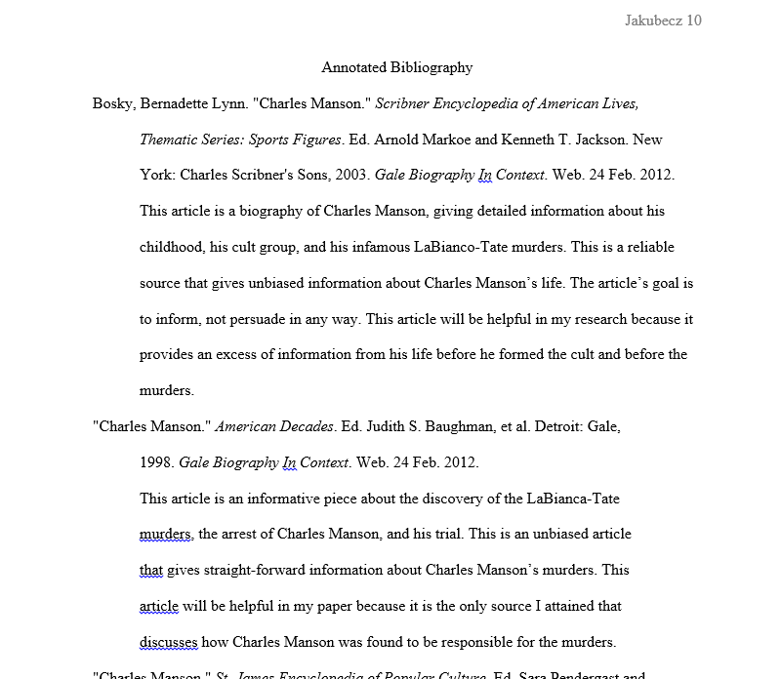
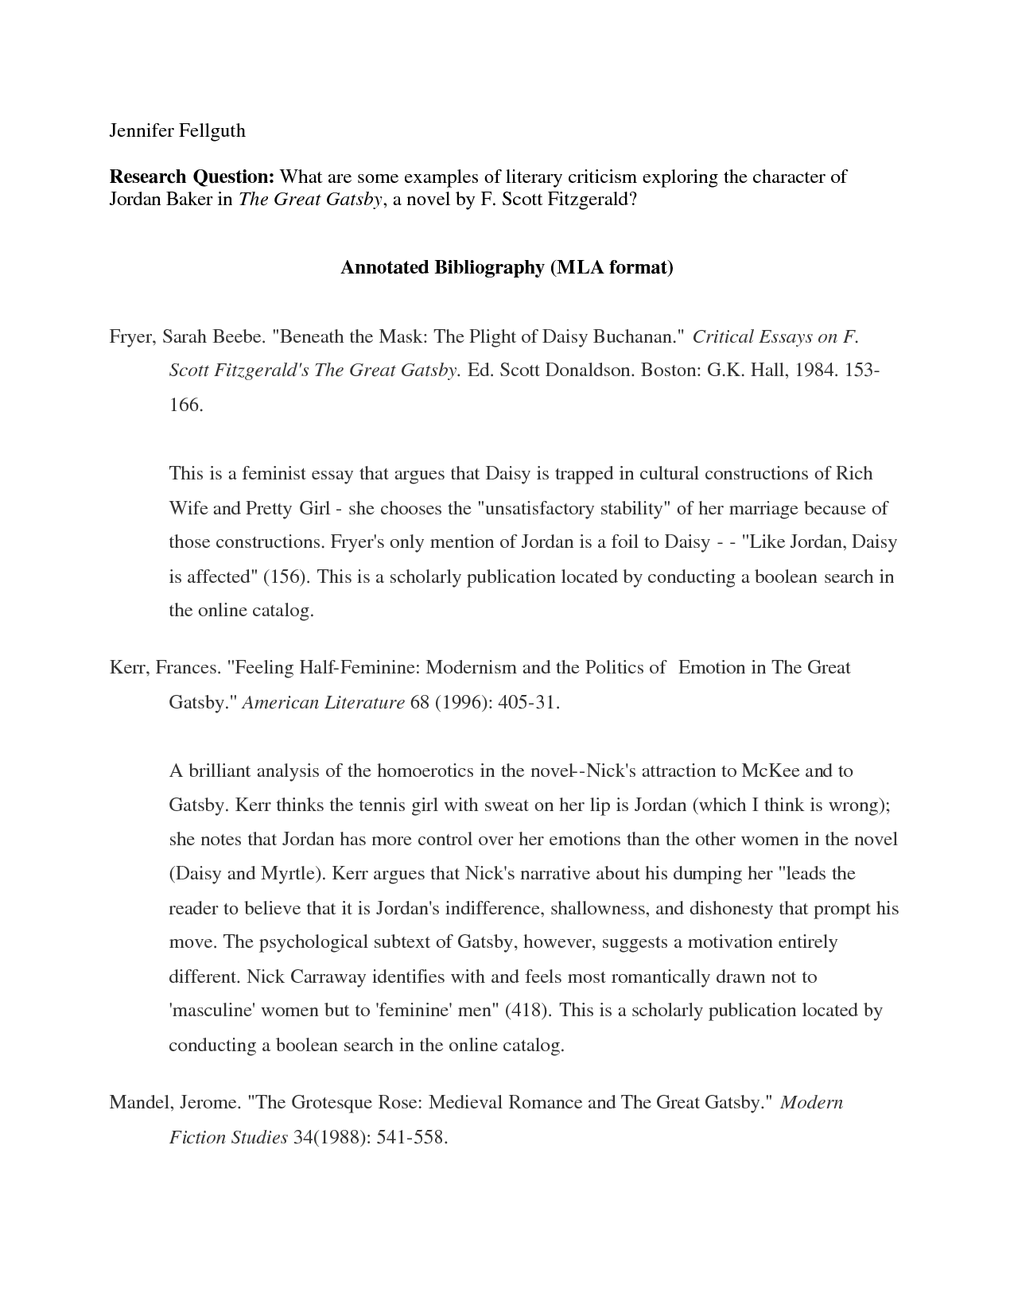
Annotated Bibliography Sample

Slide 16
Step Four: Thesis Statement
This is the most important sentence in your paper
Let’s look at the handout explaining what should be included in your research paper
Thesis should include:
Name of human monster or hero
Why he/she is deserving of the title of human monster or hero
Whether he/she is a product of nature, nurture, or a combination of both
Which is scarier: human monsters or fictional monsters
OR
Which is more inspiring: human heroes or fictional heroes
Definition of fear –OR- Definition of Heroism
*try* to put all of these pieces of the thesis into ONE SENTENCE…

Slide 17
Step Four: Thesis Statement
Some Samples
Sample 1:
____________ is a human monster due to his socially deviant behavior and crime of ____________ while demonstrating the importance of a nurturing environment, thus proving that human monsters are more frightening than fictional ones in their creation of fear.
Notice:
1. Topic is listed in the thesis
2. Informative section is recognized
3. Nature vs. Nurture is mentioned
4. Comparison of human vs. fictional monsters
5. Mention Fear
Overall…the thesis FOLLOWS the order of the paper

Slide 18
Step Four: Thesis Statement
Some Samples Cont’d
Sample 2:
In ______________’s actions of __________and ___________, he demonstrates the qualities of a human monster while showing how the combination of nature and nurture create a personality as well as proving that humans are capable of creating more fear than those written about in fiction.
Notice:
1. Topic is listed in the thesis
2. Informative section is recognized
3. Nature vs. Nurture is mentioned
4. Comparison of human vs. fictional monsters
5. Mention Fear
(this paper will discuss fear before explaining that human monsters are more frightening than fictional ones)
Overall…the thesis FOLLOWS the order of the paper

Slide 19
Step Four: Thesis Statement
Some Samples Cont’d
Sample 3:
In ______________’s actions of __________and ___________, he demonstrates the qualities of a human hero while showing how the combination of nature and nurture create a personality as well as proving that humans are capable of demonstrating bravery than those written about in fiction.
Notice:
1. Topic is listed in the thesis
2. Informative section is recognized
3. Nature vs. Nurture is mentioned
4. Comparison of human vs. fictional monsters
5. Mention of Bravery/Selflessness
(this paper will discuss bravery before explaining that human heroes are more courageous than fictional ones)
Overall…the thesis FOLLOWS the order of the paper

Slide 20
Step Four: Thesis Statement
Some Samples Cont…
Sample 4:
____________ is a human hero due to his intrinsic motivation and heroic deed of ____________ while demonstrating the importance of a nurturing environment, thus proving that human heroes are more compassionate than fictional ones in their selfless quest.
Notice:
1. Topic is listed in the thesis
2. Informative section is recognized
3. Nature vs. Nurture is mentioned
4. Comparison of human vs. fictional monsters
5. Mention of Selflessness/Bravery
Overall…the thesis FOLLOWS the order of the paper

Slide 21
Step Four: Thesis Statement
Remember:
After completing your research, you need to start thinking about the order of your body paragraphs!
The thesis statement needs to follow the order of your body paragraphs. This means that:
Your human monster’s/hero’s name should be mentioned within the first few words of the thesis
The informative section should be mentioned before the analytical section
*****************************************************
This is the last sentence of your introduction paragraph
This is only one sentence in length
Should be a complex sentence (show me that you have been writing thesis statements for at least three years)

Slide 22
Step Five: Introduction Paragraph
Attention Grabber / Hook Options:
Anecdote – a short story. If you have come across an intriguing story related to your topic, then begin your paper with this story. Most readers enjoy stories and this could help reveal characteristics about your human monster/hero.
Quotation. Make sure that this quote is relevant to the topic of your paper. You also need to comment on this quotation. DO NOT just write a quote and then move to a new topic! You need to explain HOW and WHY this makes sense in your paper.

Slide 23
Step Five: Introduction Paragraph
Anecdotal Use:
On a summer night in 1971, __________ did not expect this to be her final goodbye to her fiancé of two years. After walking down ____________ street, she was only three miles from home. Meanwhile, _____________ was lurking in the between the __________ and the ____________.
Notice the setting and “characters” (should really be the victim and the killer) in this short story
Most of you can use this as a hook because you have found interviews and/or research on the victims of the killer
Perhaps if you are going to discuss the nurture side of this person’s life, you can use create a story about what his/her childhood was like

Slide 24
Step Five: Introduction Paragraph
Anecdotal Use:
On a summer night in 1971, __________ did not expect this to be his final night of an average middle class man. After walking down ____________ street, he was only three miles from home when he heard the whimpering of an infant.
Notice the setting and “characters” (should really be the person in need and the hero) in this short story
Most of you can use this as a hook because you have found interviews and/or research on the person in need and hero
Perhaps if you are going to discuss the nurture side of this person’s life, you can use create a story about what his/her childhood was like

Slide 25
Step Five: Introduction Paragraph
Use of Quotation
Before his execution, _______________ stated, “……………………………….” (put where you found this quote in the parentheses). These final words show how…………… while also explaining why……………… Although shocking, ______________ truly believed that ……………….
Notice that I introduce the quotation
Notice that I include the parenthetical citation
Notice that I include sentences in MY OWN WORDS that explain what this quotation means

Slide 26
Step Five: Introduction Paragraph
Use of Quotation
Before receiving her award, _______________ stated, “……………………………….” (put where you found this quote in the parentheses). These words show how…………… while also explaining why……………… Although shocking, ______________ truly believed that ……………….
Notice that I introduce the quotation
Notice that I include the parenthetical citation
Notice that I include sentences in MY OWN WORDS that explain what this quotation means

Slide 27
Step Five: Introduction Paragraph
Attention Grabber / Hook Options:
Shocking statement; Series of shocking statements
Shocking fact or statistic; series of shocking facts or statistics
DO NOT USE A QUESTION AS A HOOK!

Slide 28
Step Five: Introduction Paragraph
After the hook, provide necessary background information
Define your topic
Make sure your audience is aware of who this person is before you go into the thorough detail
Think of these as transition sentences between your hook and thesis statement
Approximately 2-3 sentences would be appropriate

Slide 29
Step Six: Informative Body Paragraphs
Parenthetical Citations
These paragraphs will have the majority of the citations in your paper
Remember, a strong informative body paragraph has citations from MORE THAN ONE SOURCE
_______________’s complicated life began in Cleveland, Ohio. He was the third child born to a single mother (Smith). According to Time Magazine, “____________’s mother had to work three jobs to keep food on the table, so he was raised by his older sister.” Additionally, one of his mother’s jobs required her to work the night shift, so the children were responsible for waking up in the morning and going to school (Jackson). As __________ became older, he started having difficulty in academics and he never earned a high school diploma (Smith). While working at McDonald’s, ____________ met his future wife.
*Notice how I am citing more than one source in the start of this body paragraph! This shows an advanced level of research and writing skills.*

Slide 30
Step Six: Informative Body Paragraphs
Parenthetical Citations
You need to follow the rules that are created by the Modern Language Association!
Please use THE OWL to help
You need to read through the entire page on MLA Citations
This should be review for you!
This explains how to cite sources that might have more than one author, no author, or works that have the same title
While in the Academic Lab, you should ask the teacher to check over your citations because these are worth a significant grade of your paper

Slide 31
Step Seven: Analytical Body Paragraphs
Nature vs. Nurture Body Paragraph
In the beginning of the paragraph, you should define nature and nurture as well as thoroughly explain the differences between the two
Be sure to CITE where you found your definition(s) of nature and nurture
After these definitions, you should explain HOW and WHY your human monster/hero demonstrates nature, nurture, or a combo of both
You should be able to PROVIDE THREE or more examples that explain HOW and WHY

Slide 32
Step Seven: Analytical Body Paragraphs
Nature vs. Nurture Body Paragraph
Example:
Throughout ___________’s actions, the importance of nurture is demonstrated. According to ________, nurture is “____________________.” This means that …*this is where you should take the definition and paraphrase, which shows that you understand the definition thoroughly.* Contrary to this concept, nature is the ____________________ (Smith). Dr. Smith, a professor of Psychology at Harvard University, clearly defines nature as … …*this is where you should take the definition and paraphrase, which shows that you understand the definition thoroughly.* Due to _________’s behavior and upbringing, one can clearly connect how his crime/heroic action is truly the result of nurture. For example, __________.
Make sure that the language in this paragraph matched the language in your thesis statement
I used “importance of nurture,” so I should have “importance of nurture” in the thesis. The thesis helps you make your topic sentences!
You might have “combination of nature and nurture” as your topic sentence based on the examples that you are going to use.

Slide 33
Step Seven: Analytical Body Paragraphs
Definition of Fear or Paragraph What adjective describes the fear that was created by the human monster/hero? Which noun would you use to explain the fear/bravery?
How are you going to use the research to help you define this type of fear?
Why is this type of fear apparent in the research?
_____________ creates ________ fear / fear of _________ through his actions of ___________, _________, and ________. Three examples = strong support!

Slide 34
Step Seven: Analytical Body Paragraphs
Remember:
This proves why
This shows how
This demonstrates why
This portrays how
This exemplifies why
Use these words throughout your analytical paragraphs

Slide 35
Step Eight: Conclusion Paragraph
In your conclusion, you should:
Restate your thesis in a new and fresh way
Perhaps you will break apart your thesis into 2-3 sentences
DO NOT copy and paste your thesis from your intro
Summarize the big idea
What do you want your audience to remember?
Think of the important information in your body paragraphs
Leave the reader with an intriguing thought
What did you learn from this paper? What did you learn about life? What did you learn about fear/bravery? What did you learn about nature/nurture? (This part is still in 3rd person)
Your thesis went from general to specific…your conclusion should go from specific to general. This means that your last sentence is a “big idea” type of sentence.

Slide 36
Common Mistakes
No Hanging Quotations!
You are FORBIDDEN to have a sentence that starts with quotation marks and ends with quotation marks. You must introduce all quotations.
EX: ___________ spent his early years in Cleveland, Ohio. “He did not have many friends in school and was a bit of a loner.” After graduating, he attended Ohio State University.
FIX: ___________ spent his early years in Cleveland, Ohio. According to Joe Smith, author of Biography, “He did not have many friends in school and was a bit of a loner.” After graduating, he attended Ohio State University.
This quotation is no longer “hanging” because I incorporated an introduction and some of my own words.
Notice how I give credibility to the author to show my audience that this is a valid source!

Slide 37
Common Mistakes
Quotations and Citations
Grammatically Correct (notice the punctuation)
He believed that their album, the White Album (1969), “both foretold and encouraged” a race war (“Charles Manson” American).
Atkins went on to say that the orders that Manson did give them “would not come from inside him, [they] would come from what I would like to call the Infinite” (qtd. in “Helter Skelter”).

Slide 38
Common Mistakes
Quotations and Citations
Grammatically Correct (notice the punctuation)
When Atkins was asked on trial if Watson told her why they were going to this residence, she said, “To get all of their money and to kill whoever was there” (qtd. in “Helter Skelter”).

Slide 39
Common Mistakes
Quotations and Citations
Using the ellipses
According to Dr. Joseph Smith of Harvard University, one with heroic tendencies often “displays the characteristics of altruism and bravery … during trying times” (33).
* … = I took something out

Slide 40
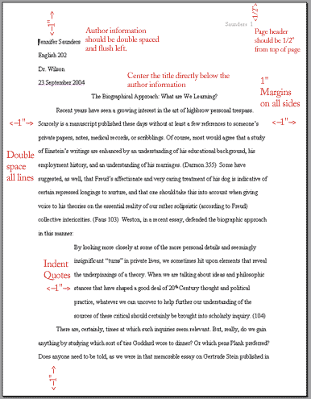
Common Mistakes
Quotations and Citations: The Block Quote

Slide 41
Common Mistakes
Topic Sentences and Concluding Sentences in YOUR OWN WORDS
Do not start a paragraph with a quotation (unless it is your hook)
Throw in an “overall” if you’re desperate for a concluding sentence
NO CITATION at the end of the paragraph b/c the concluding sentence is your own idea

Slide 42
Common Mistakes
Look at your previous papers…where did you make mistakes? What do you commonly get marked off?
You should make a list of “things” that you need help with before you go to the Academic Lab
Bring the rubric, directions, and specific questions
DEMON SHEET
Control F or
Edit Find

Slide 43
Before Your Final Draft is Collected
Let’s “code” your paper
Staple your rubric to the paper (on the top, please)
Underline your thesis in the introduction and where you restate it in a new and fresh way in your conclusion
Number your citations (parenthetical and according to)- 16 total
Number your direct quotes- 4
Highlight your citations and use the same color highlighter to show that this citation corresponds with a source on the Annotated Bibliography
Highlight anywhere where you use “This proves / demonstrates / shows / exemplifies”
You must “code” your final draft that will be collected on Tuesday 2-16-16
Make sure that you prepare for the speech portion!

