Slide 1
English Renaissance
1485-1660

Slide 2
Renaissance History
Historical periods are created later by historians so they are inexact. This is why the period is unknown to the people living in it.
What do you think our historical period will be called?
How will the years be grouped together?
Renaissance begins in Italy and moves north.
Renaissance means “rebirth”.
There was a renewed interest in classical learning and writing of the ancient Greeks and Romans.

Slide 3
Renaissance History
The intellectual environment of the Renaissance developed as people became interested in the writing of ancient Greece and Rome. They became more inquisitive and creative.
Renaissance art reflected the increasingly worldly spirit of the era
Michelangelo, Raphael, Leonardo da Vinci
“universal man” or “Renaissance man”
Capable of many accomplishments in a number of fields
Example: Leonardo- accomplished painter, scientist, and engineer

Slide 4
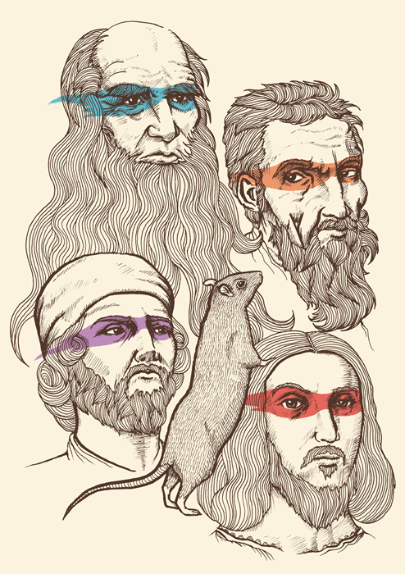
Just think of TMNT

Slide 5
Renaissance History
Age of Exploration
- Columbus arrives in western hemisphere 1492
- Cabot reaches New Foundland 1497; basis for future claims by England.
- By 1610, almost the entire world had been drawn together into a single network of trade connected by ships Portugal, Spain, England, France, and the Netherlands
**Consider: the spirit of curiosity and openness is reinforced by reports from sailors and adventurers…unknown lands, foreign peoples and customs, and exotic trade goods

Slide 6
Renaissance History
Religion
- Some saw Roman Catholic Church as corrupt
- Others questioned hierarchy and teachings
*Remember: The importance of the Catholic Church in the Middle Ages?
- Church law operated through courts
- All universities were governed and directed by churchmen
- Influenced great events in people’s lives: birth, marriage, death

Slide 7
Renaissance History
Humanism – combined the wisdom of the classics with that of the Bible, emphasizing the ideals of wisdom and virtue.
Erasmus (1466-1536) was a humanist who raised questions about standard interpretations of the Bible, thus laying the groundwork for a split from the church. He wanted to restore Christianity to its earliest simplicity as taught by Christ.
He wrote “In Praise of Folly” criticizing the church’s policies on fasting, pilgrimages, and Biblical interpretations.
Consider the corruption that was explored in “The Prologue” of The Canterbury Tales.
Renaissance Crash Cource

Slide 8
Sir Thomas More, another humanist, wrote “Utopia” in 1516, a famous treatise on human society.
Satire
Published to show the poor condition of British life
The idle rich, unjust social system
He wrote in Latin like Erasmus.
The spread of scholarly Latin throughout Europe made possible the sharing of ideas.

Slide 9
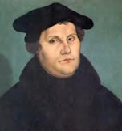
Reformation - Split from the Catholic Church
German monk Martin Luther nailed a list of dissenting beliefs (“ninety-five theses) to the door of a German church.
The intent was to reform the Catholic Church, but actually divided the church and introduced Protestantism.
Most people felt the Church of England was insufficiently reformed and was just a copy of Catholicism. For this reason many people were dissatisfied with the new church in the mid-1500s.

Slide 10
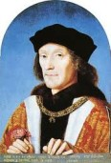
The Tudors
In England, the historical event that marked the beginning of the Renaissance is the end of the War of the Roses (the civil war between the houses of Lancaster and York).
King Richard III was killed at the Battle of Bosworth (August 22, 1485). He was defeated by Henry Tudor.
The Tudor family took control of the English monarchy.
Henry VII - the first Tudor monarch.
Henry's Wives

Slide 11
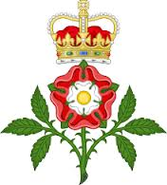
Henry VII
- He was concerned with healing the wounds of political dissent and economic depression after the War of the Roses.
- He restored peace and order allowing the Renaissance to take place.
- He avoided costly wars.
- He encouraged trade which he taxed.
- He acquired a large fortune for the crown by taxing the poor harshly.

Slide 12
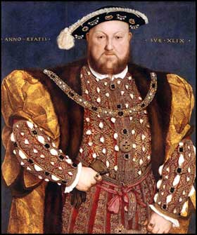
Henry VIII succeeded Henry VII.
As a second son, he was intended for the religious life. His older brother, Arthur, was groomed to be king. Arthur was married (at the age of 15) to Catherine of Aragon, but he died a few months after his marriage.
Catherine’s parents were Ferdinand and Isabella of Spain – they financed Columbus, and were the architects of the Spanish Inquisition. Monty Python Spanish Inquisition
Henry was considered a “Renaissance Man” because he was scholarly, musical, athletic, and literary.
Review of Henry VIII

Slide 13
Henry VIII reigned from 1509-1547
Henry VIII wrote a book against Martin Luther and was given the title “Defender of the Faith” by the Pope.
Henry had six wives.
His first wife was Catherine of Aragon, his brother’s widow. His marriage to Catherine produced a daughter, Mary.
Because his 20 year marriage to Catherine of Aragon did not produce a son, Henry VIII wanted to divorce her and marry his “mistress” Anne Boleyn. She refused to sleep with him until they were married; she gave in 7 years later, and immediately became pregnant.

Slide 14
Cardinal Wolsey (the Archbishop of York) tried repeatedly to secure a legal annulment from Pope Clement VII, but Clement was being held captive by Charles V, (The Holy Roman Emperor and nephew of Catherine)
“The Great Matter” of Henry’s divorce took over seven years – he finally broke with Rome himself when Anne became pregnant.
Henry summoned the Reformation Parliament in 1529, which passed 137 statutes in seven years and exercised an influence in political and ecclesiastic affairs which was unknown to feudal parliaments.
By 1536, all ecclesiastical and government officials were required to publicly approve of the break with Rome and take an oath of loyalty.

Slide 15
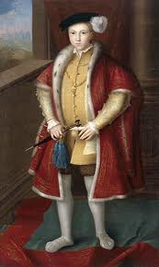
Henry VIII split from the Catholic Church and formed the Church of England (Anglican Church), and made himself the head of the church.
This was the beginning of Protestantism in England, although Henry considered himself a Catholic until his death.
His marriage to Anne Boleyn produced another daughter, Elizabeth (who later became one of the strongest and most successful monarchs in the history of Britain).
His marriage to Jane Seymour produced a son, Edward. Jane died in childbirth. Because she produced a son, Jane was Henry’s favorite wife, and he is buried with her.

Slide 16
“Divorced, beheaded, died; Divorced, beheaded, survived”

Slide 17
Henry VIII – the early part of Henry’s reign saw the young king invade France, defeat Scottish forces at the Battle of Foldden Field,and write a treatise denouncing Martin Luther’s Reformist ideals, for which the pope awarded Henry the title “Defender of the Faith.”

Slide 18
Henry VIII’s later reign witnessed Henry’s growing involvement in government, and a series of events which greatly altered England, as well as the whole of Christendom: the separation of the Church of England from Roman Catholicism.

Slide 19
The king moved away from the medieval idea of rule as chief lawmaker and overseer of civil behavior, to the modern idea of ruler as the ideological icon of the state. In other words, he represents the philosophy and beliefs of the country.
The Best Anne Boleyn Moments: The Tudors
Tudors behind the scenes

Slide 20
Henry’s son – Edward VI became king at 9 and died at 15.
During Edward’s reign, England was becoming a Protestant nation.
English replaced Latin in the church ritual.
The Anglican Prayer book, Book of Common Prayer, was required in public worship.
Edward named his 16 year old cousin, Jane Grey, as his successor in the hopes of maintaining Protestantism in England
She was “queen” for nine days (never crowned). Mary marched into England, took the crown, and had Jane executed.
Lady Jane

Slide 21
Mary I (Edward’s half-sister) took the throne after his death and restored Catholicism and the authority of the Pope over the English church. She was nicknamed “Bloody Mary” because she executed about 300 Protestants and strengthened anti-Catholic sentiment.
She married Phillip of Spain, which gave Spain the idea that they could also rule England.
Most Evil Women in History
HH - Phillip and Mary: a Love Story

Slide 22
Elizabeth I (Mary’s half-sister) took the throne after Mary’s death.
Elizabeth had a Renaissance education. She reestablished the monarch’s power over the English Church and rejected the pope’s authority. She was known as “the Virgin Queen” because she played one suitor off against another.
She was very vain, and tried to maintain her image of youth throughout her life.
Elizabeth
Elizabeth I clip

Slide 23
Mary and Elizabeth made some people uncomfortable:
“For their sight in civil regiment is but blindness, their counsel foolishment, and judgment frenzy”
“For that woman reigneth above man, she hath obteined it by treason and conspiracy committed against God”
Most women were “fond, folish, wanton flibbergibbes, tatlers, triflers, wavering witles, without counsell, feable, careless, rashe proude…”

Slide 24
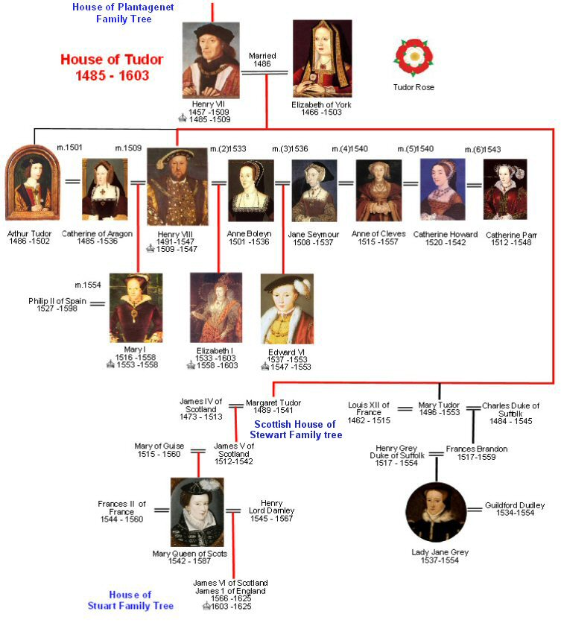

Slide 25
After Mary’s death, Phillip sent the Spanish Armada to England to try to take the country by force.
When the English Royal Navy defeated the Spanish Armada in 1588, it ensured England’s independence from the Catholic countries of the Mediterranean. It was one of Elizabeth’s greatest victories.

Slide 26
Stuarts and Puritans
James I (Elizabeth’s cousin) ascended the throne in 1603.
James and Parliament struggled for power.
James persecuted the Puritans resulting in their migration to America and establishing the Plymouth colony in 1620.

Slide 27
The Commonwealth
English Civil Wars were fought 1642 to 1651.
Charles I was beheaded in 1649.
HH - The English Civil War
Oliver Cromwell and Parliament ruled England for the next 11 years.
HH - Cromwell and Charles II
Charles II returned from exile in France in 1660.
When the people of England showed an increasing interest in secular (worldly) rather than religious values, the English Renaissance came to an end.

Slide 28
Renaissance History
The Renaissance period was characterized by a growing merchant class, rich with wealth plundered from America.
The invention of the printing with movable type created a wide availability of reading material which allowed ideas to spread quickly.
Books became more available to the common person.
Johannes Gutenberg, introduced moveable type 1455 (Bible) and William Caxton was the first to introduce the printing press to England in 1476.
Gutenberg Press

Slide 29
Renaissance History
Literature of the Time Period
- Elizabethan poetry – favored lyric poetry
rather than narrative
-narrative poems are medieval while
lyric poems are associated with the Renaissance
- Pastoral poetry – idealizes the rustic
simplicity of rural life.

Slide 30
Renaissance History
Sonnets – Sidney, Spenser, Shakespeare
Form – 14 line iambic pentameter, set rhyme scheme
Petrarchan (Italian) sonnet abba abba cdecde (octave and sestet); “turn” or volta, which signaled the change in the topic or tone of the sonnet, is after the octave.
Spenserian sonnet – abab bcbc cdcdee
Shakespearean sonnet – abab cdcd efef gg (3 quatrains and one couplet)/ turn is in the 3rd quatrain; each line is iambic pentameter (five groups of two syllables with the accent on the second) Each quatrain develops a specific idea, but is closely related to the ideas in the other quatrains; Couplet plays a pivotal role-usually is a conclusion to the poem

Slide 31
Renaissance History
Elizabethan drama – turned away from religious subjects and became more complex and sophisticated.
Ben Johnson – if not for Shakespeare, he would have been regarded as the chief dramatist of the age.
Christopher Marlowe – The Tragical History of Doctor Faustus
Shakespeare – began as an actor; plays performed in the Globe theater; wrote tragedies, comedies, and histories.
Globe Theater Video

Slide 32
Renaissance History
Elizabethan and Jacobean Prose – Scholars still preferred to write in Latin.
Prose of Sidney, Nashe, and Raleigh
Sidney Defense of Poesie – early English literary criticism.
Nashe – The Unfortunate Traveler forerunner of the novel
Raleigh – History of the World
Sir Francis Bacon – leading prose writer; wrote formal essays (short prose works on a single topic)
The King James Bible – translation of the Bible
Greatest prose achievement of the Renaissance
54 scholars worked for 7 years to complete the project
Commissioned by King James upon recommendation from Protestant clergyman
Some people think that Shakespeare was one of the translators
Parables: simple stories from which a moral or religious lesson can be drawn; Most famous-the New Testament

