Slide 1
Writing A
Thesis
Statement
© Presto Plans

Slide 2
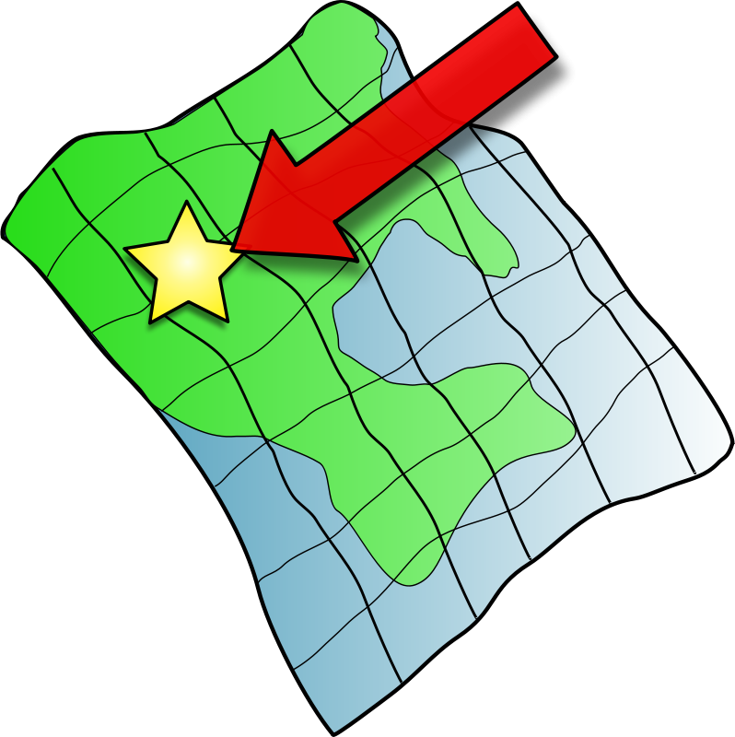
What Is A Thesis Statement?
A thesis statement is a guide map to your entire paper. For most student work, it's a one or two sentence statement that explicitly outlines the purpose or point of your paper.
The rest of the paper will support or back up your thesis, so a thesis is normally placed at or near the end of the introductory paragraph.
© Presto Plans

Slide 3
What Does A Thesis Statement Include?
The most important thing to understand before you create your thesis statement is that it MUST contain two parts, a subject (also called a topic) and an opinion or assertion about that subject. The thesis sentence must contain an arguable point. It must not simply make an observation.
Assertion
About Topic
Topic
© Presto Plans

Slide 4
What Does A Thesis Statement Include?
Strong Thesis Statement With An Arguable Point
Weak Thesis Statement That Makes An Observation
The first polygraph was developed by Dr. John A. Larson in 1921.
Because the polygraph has not been proven reliable, even under the most controlled conditions, its use by private employers should be banned.
© Presto Plans

Slide 5
Why Have A Thesis Statement?
An essay without a thesis statement is like a car without a driver
Helps you start drafting.
Helps keep you focused.
Helps to narrow your subject
Serves as a point of reference
© Presto Plans

Slide 6
Why Have A Thesis Statement?
The thesis statement must control the entire argument. Every paragraph in your paper exists in order to support your thesis.
Accordingly, if one of your paragraphs seems irrelevant to your thesis you have two choices: get rid of the paragraph, or rewrite your thesis.
© Presto Plans

Slide 7
Types Of Thesis Statements: Persuasive
A persuasive paper makes a claim based on opinion, evaluation, or interpretation about a topic and proves this claim with specific evidence.
A persuasive thesis statement attempts to convince the reader of something!
© Presto Plans

Slide 8
Types Of Thesis Statements: Persuasive
Persuasive thesis example: High school graduates should be required to take a year off to pursue community service projects before entering college in order to increase their maturity and global awareness.
© Presto Plans

Slide 9
Types Of Thesis Statements: Expository
An expository (explanatory) paper explains something to the audience.
Expository thesis example: The life of the typical college student is characterized by time spent studying, attending class, and socializing with peers.
© Presto Plans

Slide 10
Types Of Thesis Statements: Analytical
An analytical paper breaks the topic down into parts, examines each part, and determines how each part relates to the whole topic.
© Presto Plans

Slide 11
Types Of Thesis Statements: Analytical
Analytical thesis example: An analysis of the college admission process reveals one challenge facing counselors: accepting students with high test scores or students with strong extracurricular backgrounds.
© Presto Plans

Slide 12
Types Of Thesis Statements: Literary Analysis
A literary analysis paper examines a particular aspect of a literary text (theme, characterization, setting, conflict).
© Presto Plans

Slide 13
Types Of Thesis Statements: Literary Analysis
Literary analysis thesis examples:
In the characters of Daisy, Tom, and Gatsby himself, Fitzgerald’s The Great Gatsby depicts a corrupted version of the traditional American Dream.
Sinclair Lewis’ 1922 novel Babbitt relies upon the author’s use of satire to critique the ignorance, mediocrity and conformity of the American middle class.
© Presto Plans

Slide 14
What Does A STRONG Thesis Statement Have?
A STRONG thesis statement should:
Take A Stand – Don’t be afraid to give an opinion or criticize
Justify Discussion – Choose an argument that leaves your reader thinking rather than saying “so what” or “what’s your point?”
Be Restricted – Choose a specific and manageable topic - readers are more likely to reward a paper that does a small task well than a paper that takes on an unrealistic task and fails.
© Presto Plans

Slide 15
…But How Do I Write A Thesis Statement?
A Thesis Statement generally consists of two main parts
Your topic
The analysis, explanation, or assertion, that you’re making about the topic.
© Presto Plans

Slide 16
Example
Many college students work while attending classes.
This is NOT a strong thesis statement as it is only a topic.
Working while attending college classes remains necessary for many students, but unfortunately many problems result from the difficulties of balancing work and school.
This IS a strong thesis statement because it has a topic and an argument/assertion about that topic.
© Presto Plans

Slide 17
Thesis Statement Problems
Do NOT Do The Following:
Announce your thesis: “In this essay, I am going to tell you about Mackenzie College and why you should go there.”
Confuse your reader: Make sure that the topic and point are clear.
Cannot be a fact: Doesn’t allow you to prove anything because it’s already factual.
Don’t be vague: Words like “good,” “bad,” “right,” and “wrong,” don’t convey specific meaning.
Cannot be a question: “Don’t you think animal testing is inhumane?” Does not give the point of the paper. Leaves it open for readers to fill in the blank.
© Presto Plans

