Slide 1
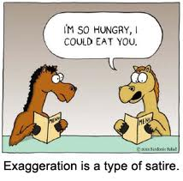
Satire
WHAT IS SATIRE? WHERE IS SATIRE EVIDENT?
LET’S START WITH A PORTRAYAL OF THE CLASSROOM
Notes:
1

Slide 2
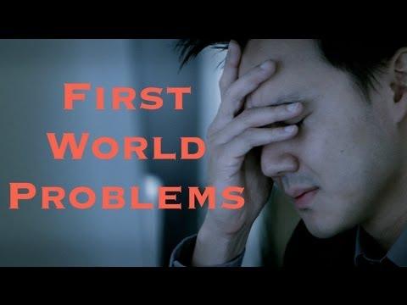
What is Satire?
Handout!
Satire: A literary work that ridicules its subject through the use of various techniques
Uses humor to expose and ridicule human vice and folly
Satire is meant to inspire reform or change one’s opinion about a subject/topic
Who is the best satirist from The Enlightenment?
Before watching this clip, consider:
How is it ridiculing
human vice?
How is it changing
the audience’s opinion
on the subject?
Notes:
2

Slide 3
What is Satire?
Handout!
Satirical Techniques:
Exaggeration: To enlarge, increase, or represent something beyond normal bounds so that it becomes ridiculous and its faults can be seen
Incongruity: To present things that are out of place or are absurd in relation to its surroundings
Irony: Contrast between reality and appearance.
The outcome is the opposite of what is expected to happen
Saying one thing, but the meaning is the opposite (i.e. sarcasm)
Parody-To imitate the techniques and/or style of some person, place or thing
Notes:
3

Slide 4
Satirical Techniques-Exaggeration
Exaggeration: To enlarge, increase, or represent something beyond normal bounds so that it becomes ridiculous and its faults can be seen Black Friday!
Example: Caricature-the exaggeration of a physical feature or trait (often seen in political cartoons)
Beyonce and Jay-Z w/Blue Ivy
Jimmy Fallon and Mick Jagger “Mirror”
Solange and Jay-Z Elevator Incident (begin at 1:30)
Mom Translator

Slide 5
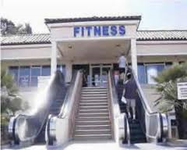
Satirical Techniques-Incongruity
Incongruity : To present things that are out of place or are absurd in relation to its surroundings
Examples: Oxymoron, metaphor, and irony are used a lot here
It’s so Easy a Caveman Could do It-Geico Ad
Dissing your Dog
Shrek and Lord Farquaad

Slide 6
Satirical Techniques-Reversal
Reversal: to present the opposite of the normal order (the order of events, hierarchical order, gender roles); to present the opposite of what the author actually wants to happen in order to make a point
Example: Having a young child make decisions for a family; delivery boy makes decisions for the company president
Shrek 3-Princesses Save Themselves
Colbert and Hilary Clinton’s Age
Fox News Anchor’s Response

Slide 7
Satirical Techniques-Parody
Parody: To imitate the techniques and/or style of some person, place or thing
Mom Jeans
Al Gore, George W. Bush (start at 2 minutes)
Andy Samberg as Nicolas Cage
https://screen.yahoo.com/weekend-cage-000000391.html (Andy Samberg, Nicolas Cage)
Luther, the Anger Translator

Slide 8
Think About Social Change
Democratic Debate
How is SNL commenting on society?
Other Ideas?

