Slide 1
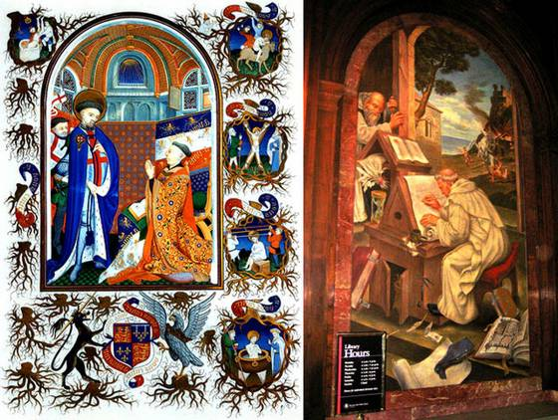
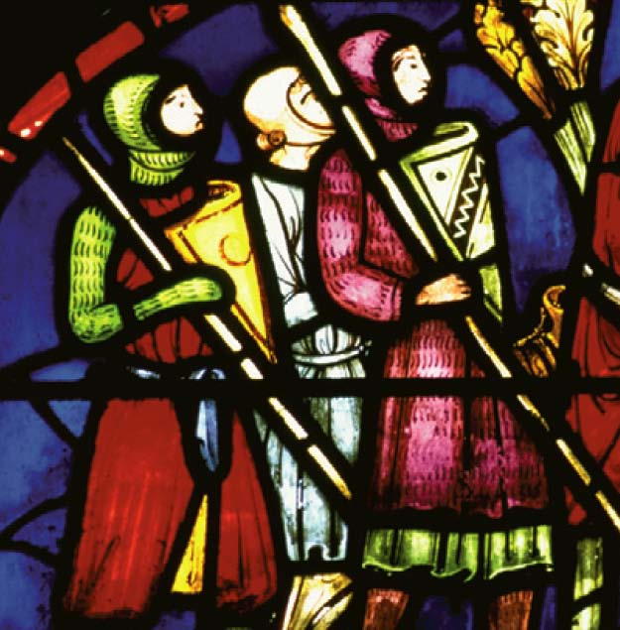
The Middle Ages
1066 - 1485

Slide 2
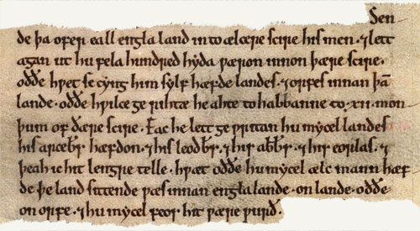
A Quick Review…
Battle of Hastings Review

Slide 3
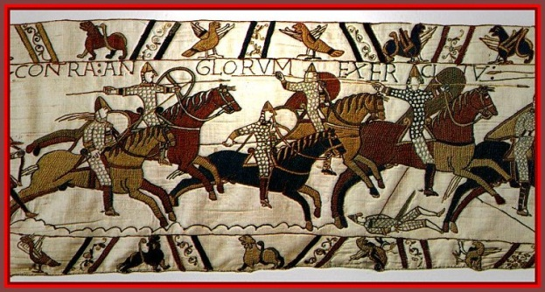
I. The Norman Conquest
Began in October 1066 when Duke William of Normandy (William the Conqueror) defeated King Harold of England
A. William was the cousin of English King Edward the Confessor who was childless when he died in 1066
Harold, the Earl of Wessex, was crowned King, but William claimed Edward promised him the throne.
B. William wanted to rule the Anglo-Saxons, not eliminate them. The two cultures intermingled.
Norman Conquest in 3 Min

Slide 4
I. The Norman Conquest cont’d
C. One of William’s great administrative feats was the Domesday Book – an inventory of nearly every piece of property in England Domesday Book
- For the first time people could be taxed based on what they owned
D. William divided the holdings of the fallen English landowners among his own followers
- They created a new social system → FEUDALISM

Slide 5
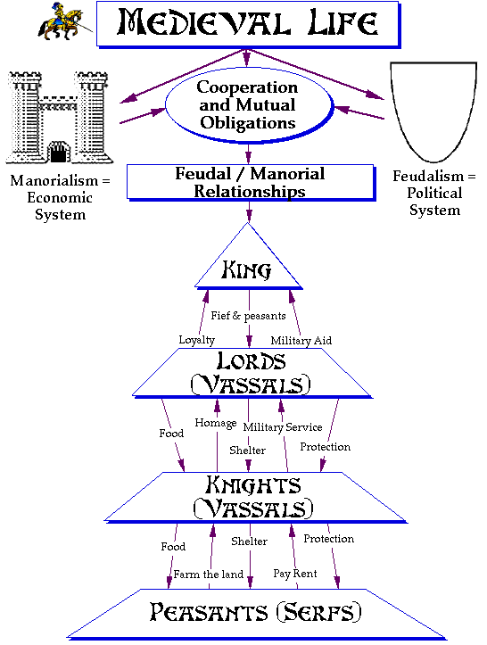
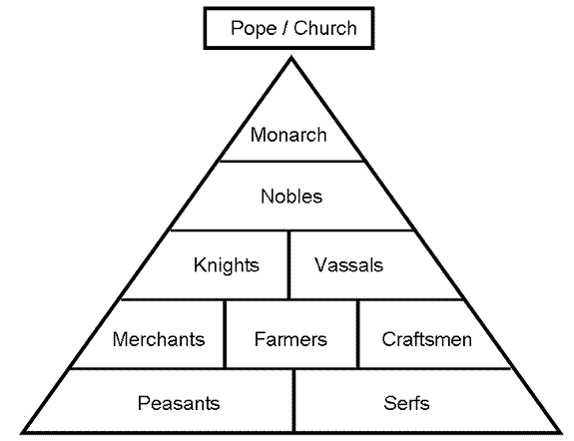
II. Feudalism
Feudalism is a pyramid system (caste system) based on a religious concept of hierarchy with God as the supreme overlord
The Annoying Peasant from Monty Python

Slide 7
II. Feudalism cont’d
A. The primary duty of males above the serf class was military service to their lords.
1. Boys were trained from an early age to become warriors. They were dubbed a knight upon completion of their training.
2. Knighthood was grounded in the feudal ideal of loyalty. The virtues of chivalry included:
- Humility
- Loyalty to God, king, and country
- Courage
- Honor
- Being true to one’s word
- Protection of the weak
- Respect for women
- Generosity
- Fairness to enemies
- Developing one’s skills
- Determination to fight evil The Worst Jobs in History-to 6:30
Brave Sir Robin

Slide 8
II. Feudalism cont’d
B. The feudal system did not always work if a vassal (a feudal tenant) chose not to honor his obligations to a weak overlord.
- A man’s word was the cornerstone of social life
C. Since they were not soldiers, women had no political rights in this system.
- A woman’s social standing depended completely on her husband’s or father’s status.
- Women were subservient to men, but they ran things when their husbands were away
The Feudal System: Lego Style

Slide 9
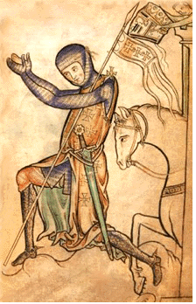
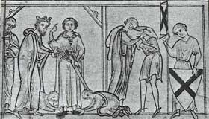
III. Chivalry
Chivalry led to an idealized attitude toward women and gave rise to a new form of literature – the Romance
A. Chivalry was a system of ideals and social codes governing the behavior of knights and gentlewomen.
1. Adhere to one’s oath of loyalty to the overlord
2. Observe certain rules of warfare
3. The Code of Chivalry did not extend to peasants
a. The “weak” was widely interpreted as “noble women and children”
b. Thus, knights were often brutal to common folk
c. Knights could rape young peasant women without fear of reprisal, all because they were part of the upper class

Slide 10
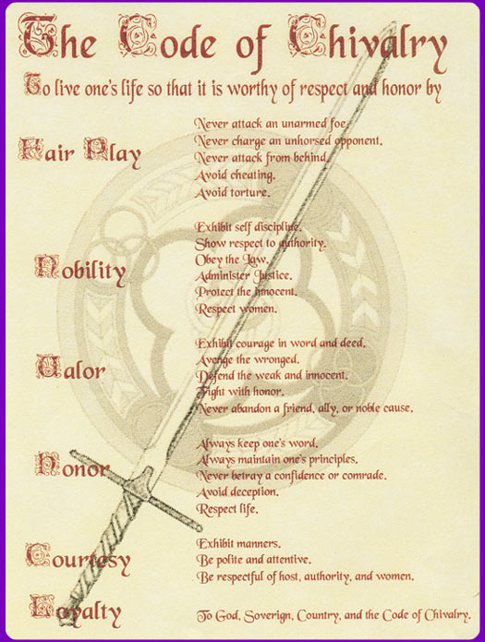
III. Chivalry cont’d
4. Knights
Should honor, serve, and do nothing to displease ladies and maidens
Were members of the noble class socially as bearers of arms, economically as owners of horse and armor, and officially through religious-orientated ceremony
Believed in the code of chivalry
Promised to defend the weak
Be courteous to all women
Be loyal to their king
Serve God at all times

Slide 11
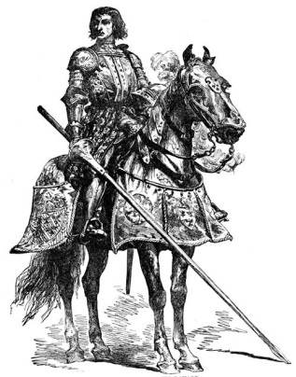
III. Chivalry cont’d
4. Knights cont’d
Were expected to be humble before others, especially their superiors. They were also expected to not “talk too much.”
Were to give mercy to a vanquished enemy
However, the very fact that knights were trained as men of war belied this code
Conquest: Weird Weapons

Slide 12
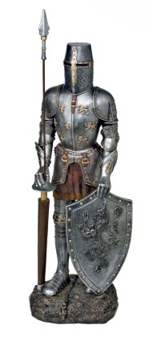
III. Chivalry cont’d
4. Knights cont’d
Came from rich families, but many were not the firstborn, so they did not receive an inheritance. This makes them little more than mercenaries.
Plundered villages or cities that they captured, often defiling and destroying churches and other property
Belonged to a multitude of specific Orders, each established for one purpose or another
Most Orders emphasized components of piety, faith, humility, chastity or some other worthy ideals

Slide 13
The Most Well-Known Knights
Hospitallers
Teutonic
Templars

Slide 14
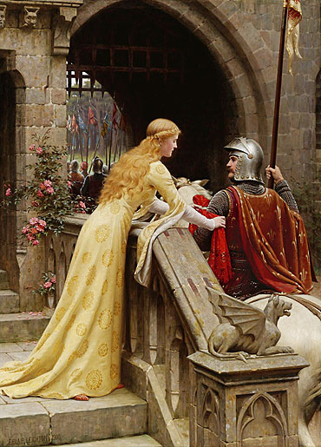
III. Chivalry cont’d
B. Courtly love → non-sexual → acting in the name of a lady
- A knight would wear his lady’s colors, but the lady remained pure and out of reach
literary example: Lancelot and Guinevere crossed the line, and Camelot fell
C. Women’s position in society did not improve

Slide 15
III. Chivalry cont’d
D. Etymology
The word evolved from…
Chevalier (French)
Caballero (Spanish)
Cavaliere (Italian)
These words all mean “a warrior who fought on horseback”

Slide 16
III. Chivalry cont’d
Some Big Ideas Associated with Courtly Love
Marriage is no real excuse for not loving.
He who is not jealous cannot love
No one can be bound by a double love.
It is well known that love is always increasing or decreasing.
That which a lover takes against the will of his beloved has no relish.
Boys do not love until they arrive at the age of maturity.
When one lover dies, a widowhood of two years is required of the survivor.
No one should be deprived of love without the very best of reasons.
No one can love unless he is impelled by the persuasion of love.
Love is always a stranger in the home of avarice.
It is not proper to love any woman whom one would be ashamed to seek to marry.
A true lover does not desire to embrace in love anyone except his beloved.
Think about how this compares to modern associations of love before we look at more of these ideas…

Slide 17
III. Chivalry cont’d
Some more ideas associated with courtly love
When made public, love rarely endures.
The easy attainment of love makes it of little value, difficulty of attainment makes it prized.
Every lover regularly turns pale in the presence of his beloved.
When a lover suddenly catches sight of his beloved, his heart palpitates.
A new love puts to flight an old one.
Good character alone makes any man worthy of love.
If love diminishes, it quickly fails and rarely revives.
A man in love is always apprehensive.
Real jealousy always increases the feeling of love.
Jealousy, and therefore love, are increased when one suspects his beloved.
He whom the thought of love vexes eats and sleeps very little.
Every act of a lover ends in the thought of his beloved.
A true lover can never have enough of the solaces of his beloved.
Love can deny nothing to love.
A slight presumption causes a lover to suspect his beloved.
A man who is vexed by too much passion usually does not love.
A true lover is constantly and without intermission possessed by the thought of his beloved.
Nothing forbids one woman being loved by two men or one man by two women.

Slide 18
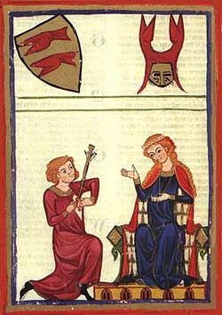
The Twelve Chief Rules in Love From The Art of Courtly Love by Andrea Capellanus
Thou shalt avoid avarice like the deadly pestilence and shalt embrace its opposite.
Thou shalt keep thyself chaste for the sake of her whom though lovest.
Thou shalt not knowingly strive to break up a correct love affair that someone else is engaged in.
Thou shalt not chose for thy love anyone whom a natural sense of shame forbids thee to marry.
Be mindful completely to avoid falsehood.
Thou shalt not have many who know of thy love affair.

Slide 19
The Twelve Chief Rules in Love From The Art of Courtly Love by Andrea Capellanus
Being obedient in all things to the commands of ladies, thou shalt ever strive to ally thyself to the service of Love
In giving and receiving love’s solaces let modesty be ever present.
Thou shalt speak no evil.
Thou shalt not be a revealer of love affairs.
Thou shalt be in all things polite and couteous.
In practising the solaces of love thou shalt not exceed the desires of thy lover.

Slide 20
IV. Medieval Society
For the most part medieval society centered around the feudal castle, but as the population grew, many people lived in towns and cities.
A. This led to the eventual collapse of the European feudal system
B. It led to the development of lower, middle, and upper-middle classes
literary example: The Prologue in the Canterbury Tales
C. These people were free, tied neither to the land nor to knighthood and chivalry
- This point of view was expressed in ballads, in mystery and miracle plays, in cathedrals, and in municipal buildings

Slide 21
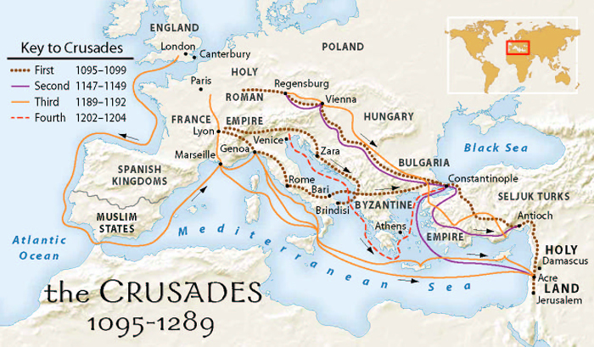
V. Specific Events that Influence English History and Literature
Several specific events radically influence the course of English history and literature
A. CRUSADES (1095-1270) were a series of wars waged by European Christians against Muslims
1. Jerusalem and the Holy Land was the prize
2. The Europeans failed, but they benefited enormously from contact with the higher civilization of the Middle East
The Crusades HH Link

Slide 22
V. Specific Events that Influence English History and Literature cont’d
B. The 1170 martyrdom of Thomas a Becket, the Archbishop of Canterbury, led to greater power for the Church of Rome.
1. Thomas, a Norman, has risen to great power under his friend King Henry II (reigned 1154-1189)
2. All Christians belonged to the Catholic Church
3. The pope in those days was enormously powerful and controlled most of the crowned heads of Europe
4. Henry hoped to gain the upper hand in disputes with the church, but often Thomas took the pope’s side
5. Four of Henry’s knights murdered Becket in his own cathedral. Becket became a martyr, and public outrage turned against King Henry
6. This outrage helped to develop the concept of corruption in the church because the church was allowed to gain greater power (show in TCT)
7. The medieval church did have one positive effect: it fostered cultural unity
a. The church continued to be the center of learning
b. The church fostered common beliefs and symbols
Old School Trailer for Becket

Slide 23
V. Specific Events that Influence English History and Literature cont’d
C. In 1215 English barons forced King John (who was backed strongly by the pope) to sign the Magna Carta as an effort to curb the Church’s power
1. Heralded a return to older, democratic tendencies
2. This document later became the basis for English constitutional law

Slide 24
V. Specific Events that Influence English History and Literature cont’d
D. The English lost the Hundred Years’ War (1337-1453) with France, but in the process they began to think of themselves as British rather than Anglo-Norman
1. This may be considered the first national war waged by England against France
2. Based on dubious claims to the throne of France by two English Kings: Edward III (reigned 1327-1377) and Henry V (reigned 1413-1422)
3. After the war England was no longer best represented by the knight. Instead, the were represented by the yeoman (small landowner)
a. With this, modern democratic England was born
b. An English national consciousness gradually developed

Slide 25
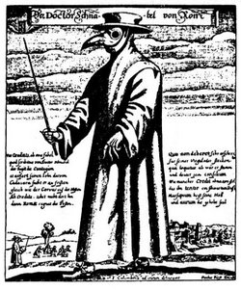
V. Specific Events that Influence English History and Literature cont’d
E. The Black Death or bubonic plague (1348-1349) delivered another blow to feudalism
1. Very contagious; spread by fleas from infected rats
2. Reduced the nation’s population by 1/3
- This was approximately 34 million people
- This caused a labor shortage which gave the lower class more leverage against their overlords
3. One long term result was the serfs’ freedom and greater power to the lower class
4. This led to the end of feudalism marking the end
of the Middle Ages
Bring Out Your Dead
HH Peasants Plague

Slide 26
Common Remedies for the Black Death:
1. Apply sterile egg whites
2. Give the patient a treacle
3. Swaddle the patient and shave the sign of the cross into her head

Slide 27
VI. Health
A. As the populations of medieval towns and cities increased, hygienic conditions worsened
B. Medical knowledge was limited and an adequate health care system did not exist
C. Antibiotics were not invented until the 1900s and it was almost impossible to cure disease without them

Slide 28
VI. Health Cont’d
D. Many myths about health and hygiene existed
1. disease was spread by bad odors
2. disease of the body resulted from sins of the soul
3. many sought relief through meditation, prayer, pilgrimages, and other nonmedical methods

Slide 29
VI. Health Cont’d
E. The body was viewed as part of the universe
1. four “humors,” or body fluids, were directly related to the four elements
a. fire = yellow bile or choler
b. water = phlegm
c. earth = black bile
d. air = blood
2. these elements had to be in balance to ensure health
F. Bloodletting was a popular method of restoring health and “humors”
G. Early surgery was often done by barbers without anesthesia
The Worst Jobs in History: Leeches-from 6:30

Slide 30
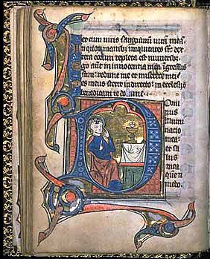
Literature Connection
Illuminated Manuscripts

Slide 31
Literature Connection
The Canterbury Tales
Geoffrey Chaucer
1387: Poem about the pilgrimage to St. Thomas a’ Becket’s shrine
Composed in Middle English
The Prologue in Middle English

Slide 32
Literature Connection
The Pilgrimage to Becket’s Shrine
Remember: Becket disagreed with King Henry II and was murdered in Canterbury Cathedral
There have been several miracles in this cathedral
After all the miracles, a shrine was put up in the cathedral
Becket was canonized a saint
People set out on a pilgrimage, to Canterbury Cathedral to pay homage to the shire of St. Thomas a’ Becket. Some believed that shrine had healing powers

Slide 33
Literature Connection
The Canterbury Tales
SETTING: April, The Tabard Inn
“Prologue”- 29 pilgrims, the narrator, and the inn host are introduced
The 29 are spending the night at the Tabard Inn.
The Narrator says he will describe and repeat everything he hears no matter how offensive.
The Host proposes that each pilgrim tell 2 tales on the way there and back.
The best tale will win dinner at the Inn

Slide 34
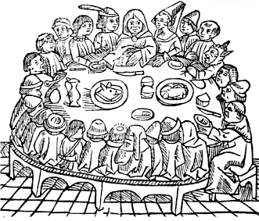
Literature Connection
The Canterbury Tales
The pilgrims are made up of all 3 divisions of class in medieval society:
Feudal class
The Church
Merchant class

Slide 35
Literature Connection
The Prologue
Chaucer’s characterization was unlike anything ever written before.
He creates a human encyclopedia by describing physical, social, mannerisms, beliefs, and morals of each character.
The Characters
After the pilgrims are introduced in the prologue each character tells his or her own tale.
The Mark Steel Lectures

