Slide 1
Gothic Literature

Slide 2
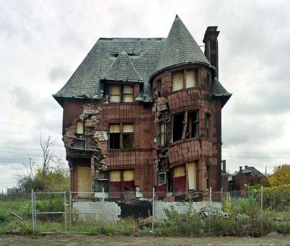
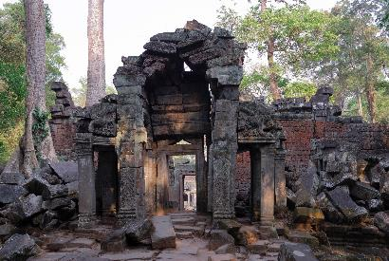
What makes it “gothic”?
Setting: Where, or what time period, the story takes place.
Old Castle
Creepy house
Falling apart/abandoned home
Ruins

Slide 3
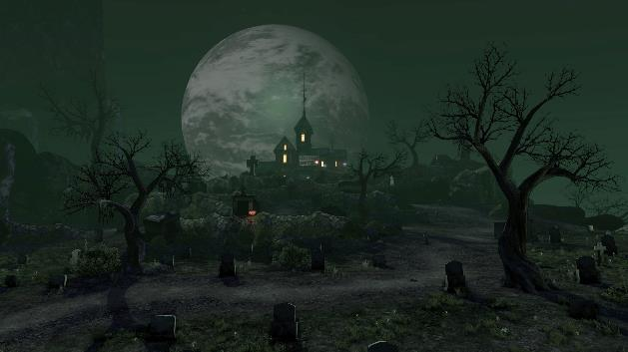
Atmosphere/Tone
: the general attitude of a place or piece of writing.
Dark
Eerie
Threatening
Fearful
Mysterious
Depressing

Slide 4
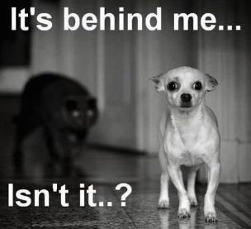
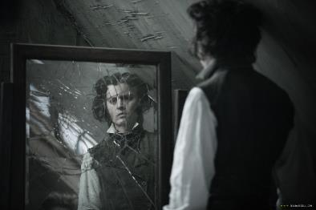
Omens or Visions
:a prophecy showing an event happening in the future.
A black cat crosses your path
666
Déjà vu (feeling
like you’ve
lived
an event
before)
Mirror
breaks

Slide 5
Supernatural/Paranormal Activities
:an event that happens without reason or cause
Ghosts
Objects moving
Lights flickering
Footsteps in an
empty hallway

Slide 6
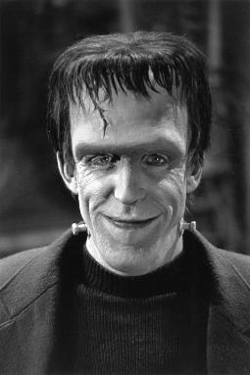
Intense Emotion
:more emotion than necessary. Usually signified by repetition of certain words pertaining to the emotion being conveyed.
“You can blast my other passions, but revenge remains-revenge, henceforth dearer than light of food! I may die, but first you, my tyrant and tormentor, shall curse the sun that gazes on your misery.” (ch 20, Mary Shelley, Frankenstein)

Slide 7
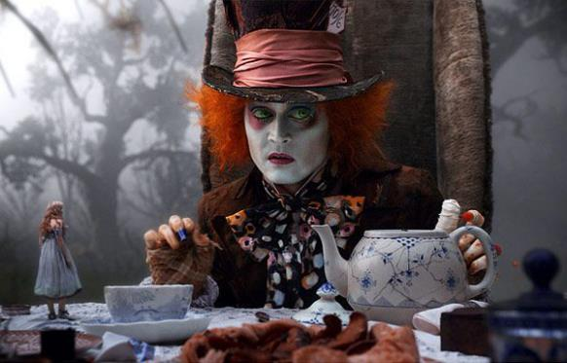
Character gone mad
:a character that was once psychologically sound but is now in psychological distress.
FUN FACT!
Did you know that hatters did actually go mad due to the chemicals that comprised the glue used to make prototypes?

Slide 8
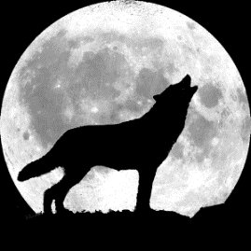
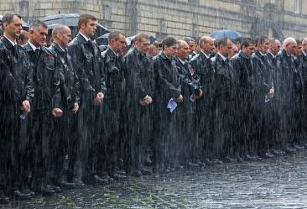
Symbols of Gloom
assist in setting tone or setting in a story.
Rain at a funeral (sadness)
Sunrise after an horrific event
(renewal/new start)
Clinking of chains
Wolves howling

Slide 9
Magical Realism
the blend of reality and fantasy so that the distinction between the two is erased
Transformation of the common and everyday into the awesome and unreal
Elements of dreams, fairy tales, or mythology combined with the everyday

