Slide 1
Ethos Pathos Logos
Looking at Persuasive Techniques
in Commercials

Slide 2
Persuasion
Many types of papers and speeches require you to use persuasion.
You (almost always!) want people to believe or do something.
Persuasion is making an appeal to sway another to believe or take action for something.
Notes:
Explain to students why this information will benefit them. They will use persuasion in their lives – in and out of school. Most people try to explain reasons why they should be believed – and naturally those reasons fall under ethos, pathos, and logos. For instance, students probably try to persuade their parents or teachers. They will also persuade a boss someday.

Slide 3
Audience
To implement methods of persuasion the best, take into account the audience.
If a commercial was made for this class, what would the audience makeup be?
Notes:
Students should add that they are teenagers, comprised of males and female, people with some money, but not a ton of money. (Answers will vary dependent upon school).

Slide 4
Methods of Persuasion
You may be familiar with the different methods of persuasion.
With or without realizing it, you will try to persuade your audience with different approaches.
Your arguments will probably fall under ethos, pathos, or logos.
Notes:
Students may know those words. Even if they don’t, they can probably guess that different approaches help persuade audiences.

Slide 5
Ethos
Ethos is an appeal to ethics. It has to do with establishing ‘character.’
To persuade, you need to establish that you are trustworthy.
Commercials strive to show their companies and products as ethical. They want consumers to trust them.
Notes:
Discuss how speakers establish ‘ethos’: tell their backgrounds, their degrees, their experiences.

Slide 6
Pathos
Pathos is an appeal to emotion. It has to do with creating a connection with the consumer.
This emotional connection engages your audience.
Commercials want viewers to remember the product. People remember ideas they feel sadness, anger, compassion, humor, or any other emotion about.

Slide 7
Logos
Logos is an appeal to logic. It persuades consumers by showing a reasonable argument.
To persuade, show logical reasons why your stance works.
Commercials want viewers to feel smart. They want to give the illusion of a good deal – that the consumer is a smart shopper.

Slide 8
Real Life
If you want to see persuasive methods in action – look at commercials.
Marketers want to persuade an audience to buy a product or service.
Commercials will contain aspects of ethos, pathos, and logos.

Slide 9
Commercials
Let’s learn from the experts by examining commercials.
The following commercials are all from insurance companies. Consider:
What are these companies trying to sell (is it only insurance)?
Who is their audience – who buys insurance?
Notes:
Those questions are important because ethos, pathos, and logos will look different for each audience. People who purchase insurance are older because they own a house or car. They probably want a good deal, but want trustworthy coverage. The audience may be students’ parents!

Slide 10
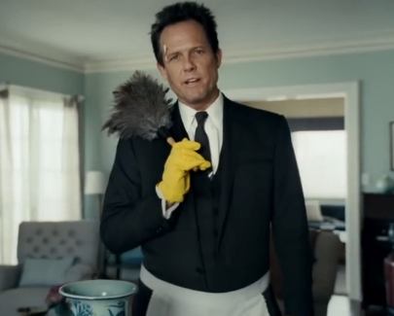
Commercial One
Commercial one is from Allstate.
It is part of the Mayhem series.
Notes:
You may need to remind students that “Mayhem” is personification. They should also listen to the voice over at the end of the commercial – after he falls down the stairs.

Slide 11
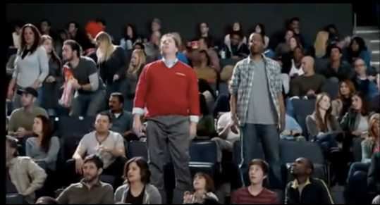
Commercial Two
Commercial two is from State Farm.
It aired during the winter, and showed a customer and an insurance agent at a basketball game.
Notes:
What is State Farm trying to say about the relationship between an employee and a customer? That they are friendly enough to go to a game together.

Slide 12
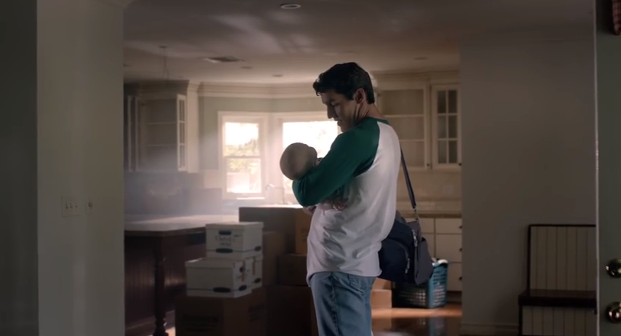
Commercial Three
Commercial three is from Travelers Insurance.
It is part of the Growing Up series.
Notes:
What major parts of the girl’s life are shown? Highlights.

Slide 13
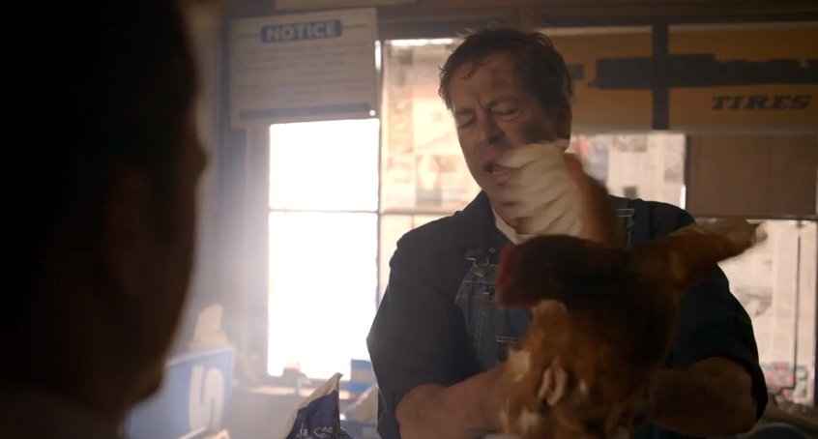
Commercial Four
Commercial four is from Square One Insurance.
It is “the chicken” commercial.
Notes:
What does the chicken symbolize? Something nobody wants or asks for – what other insurance companies are giving you.

Slide 14
Recap
You have probably realized that you have used ethos, pathos, and logos before.
If you have ever seen a commercial, you absolutely have seen examples of those persuasive techniques.
Notes:
Remind students that billions of dollars is spent on advertising each year. People who create commercials use every opportunity to drive their message!

Slide 15
Understanding
As a writer and speaker, you can learn from the experts.
Commercials are short clips of persuasion – and you can improve your persuasive techniques once you have seen ethos, pathos, and logos in action.
Your assignment is to break down the commercials by ethos, pathos, and logos.
Notes:
Now it’s time for students to study these commercials separately – in depth.

